Slide 1

Class and Objects Topic With Real time Example
By
K.SANJAY

Slide 2
About Class
A class is the blueprint of an object. A class is simply a representation of a type of object. You can think of a class as a template for making many instances of the same kind (or class) of the object.
The class is composed of normally three things: a)A name b)attributes c)methods

Slide 3
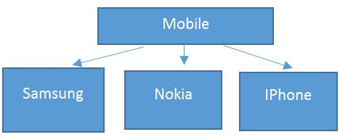
About Object
Objects are the instance of a class. An individual instance of the data structure defined by a class. Object is that thing that can perform a related activity.

